Slide 1
Final Project
Happiness ~ Life Expectancy Relationship
1/28/2021
Jeff Schmidt -- Database & Data Exploration
Duc Luu -- Machine Learning & Analysis Result
JP Enciso-Siller -- Dashboard & Github Administration
Notes:
Jeff

Slide 2
Outline
Selected Topic & Reason Selected (Jeff)
Description of the Source Data (Jeff)
Questions We Hope to Answer With the Data (Duc)
Data Exploration (JP)
Analysis & Machine Learning Phase (Duc)
Dashboard Review (JP)
Github Administration (JP)
Notes:
Jeff

Slide 3
Selected Topic & Reason Selected
Topic: The effect of various factors on happiness.
Reason: Identify correlation between independent data sets.
What factors affect happiness?
Does life expectancy impact happiness?
What factors do we think affect happiness but actually don’t?
Source Data:
https://www.kaggle.com/kumarajarshi/life-expectancy-who
https://www.kaggle.com/unsdsn/world-happiness
Data sets are from differing sources covering separate time periods.
However, seen as an opportunity to identify same relation existing despite source.
Notes:
Bar Crawl -- correlation between drinking, drunkeness & mobile device accelerometer measurement
Emphasis on concepts learned -- data set that works
Stages of selection: 1) Life Expectancy Data → 2) World Happiness inclusion

Slide 4
Description of the Source Data
Life Expectancy
Column count = 22 (exclude ID); Row count = 2938
Key columns: EXPECTANCY, STATUS, COUNTRY
Timeframe = 2000 ~ 2015
Source = World Health Organization & United Nations
World Happiness
Column count = 15 (exclude ID); Row count = 782
Key columns: Happiness Rank, Happiness Score, Health(Life Expectancy), Country
Timeframe = 2015 ~ 2019
Source = Gallup World Poll
Notes:
Jeff
Emphasize the points → table size, key columns, timeframe, & differing source

Slide 5
Description of the Source Data (cont)
LIFE_EXPECTANCY_DB (sqlite)
Issues with raw .csv files
No distinct key column
Inconsistent naming convention across files
Poor SQL naming convention within file
Two tables formed under single schema.
View created using simple inner join based on country name & common year.
INNER JOIN HAPPINESS_TABLE H ON UPPER(H.COUNTRY = UPPER(E.COUNTRY) WHERE E.YEAR = ‘2015’ and H.YEAR = 2015
Data saved to .db file format for load via SQLALCHEMY into Pandas Dataframe
Read all requirements & problem statements before hand--i.e. Take time with data gathering
Data selection was initially influenced based on what was of interest, capability to produce a result, and level of interest.
However, project data requirements expanded during 2nd deliverable (2 tables & inclusion of a JOIN).
This requirement would have influenced data selection during 1st week deliverable.
EXPECTANCY_TABLE
ID, int (PrimaryKey)
COUNTRY, text
YEAR, int
STATUS, text
EXPECTANCY, real
MORTALITY, real
INFANT_DEATH, real
ALCOHOL, real
EXPENDITURE_PERCENT, real
HEPATITUS_B, real
MEASLES, real
BMI, real
UNDER_FIVE_DEATH, real
POLIO, real
EXPENDITURE_TOTAL, real
DIPHTHERIA, real
HIV_AIDS, real
GDP, real
POPULATION, real
THIN_1TO19_YR, real
THIN_5TO9_YR, real
INC_COMPOSITION, real
SCHOOLING, real
HAPPINESS_TABLE
ID, int (PrimaryKey)
COUNTRY, text
REGION, text
HAPPINESS_SCORE, real
HAPPINESS_RANK, int
LOW_CONF, real
HIGH_CONF, real
STANDARD_ERROR, real
ECONOMY, real
FAMILY, real
HEALTH, real
FREEDOME, real
TRUST, real
GENEROSITY, real
DYSTOPIA, real
YEAR, int
Notes:
Jeff
Commonality only to COUNTRY & 2015 year
Otherwise reliant on aggregated data

Slide 6
Questions Hope to Answer with the Data
Which health factors have the biggest impact of happiness?
Which economic factors have a biggest impact on happiness?
What factors would we expect to affect happiness but actually does not?
Which country had the highest/lowest predicted happiness score?
Notes:
Duc

Slide 7
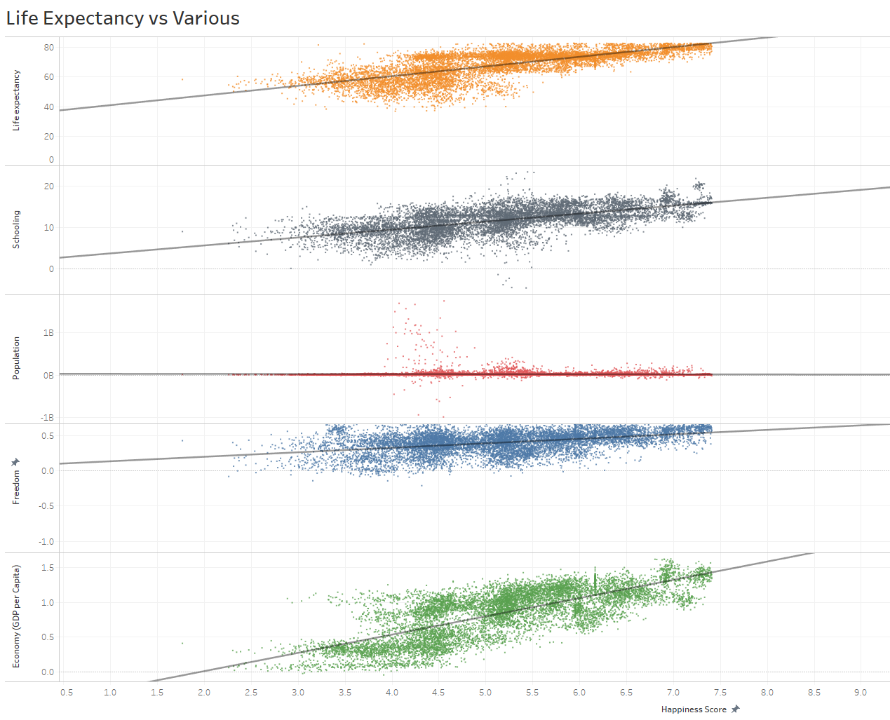
Data Exploration
Use of Tableau to plot raw data for variable columns against “Happiness Score” to find relationships
Plotted to gain a visual understanding prior to application of Machine Learning.
Early identification of potential correlation of happiness
Used as a tool to identify points of merging data
Identify what data needs cleaning and processing (ex null values, missing data, possible mistakes)
Notes:
JP

Slide 8
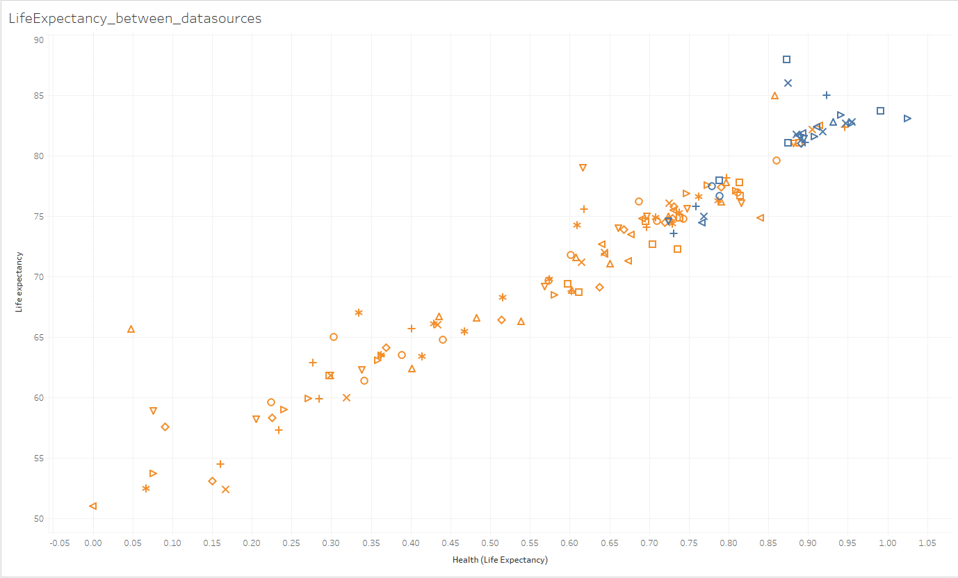
Data Exploration (cont.)
Joined data between Life Expectancy & Happiness could only be done for year 2015.
Happiness data utilizes “score” for Life Expectancy whereas Life Expectancy data uses actual age.
Visualization used to confirm linear relation between score & age.
Notes:
JP

Slide 9
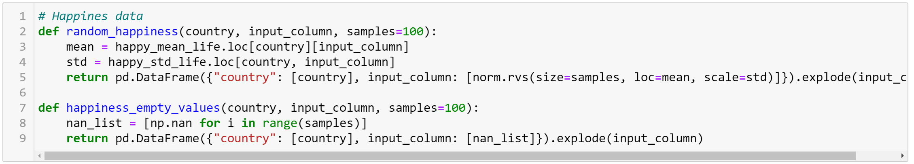
Analysis & Machine Learning Phase
Data Issues
Filling Blanks
Explode Data
Which Model Used?
Notes:
Duc

Slide 10
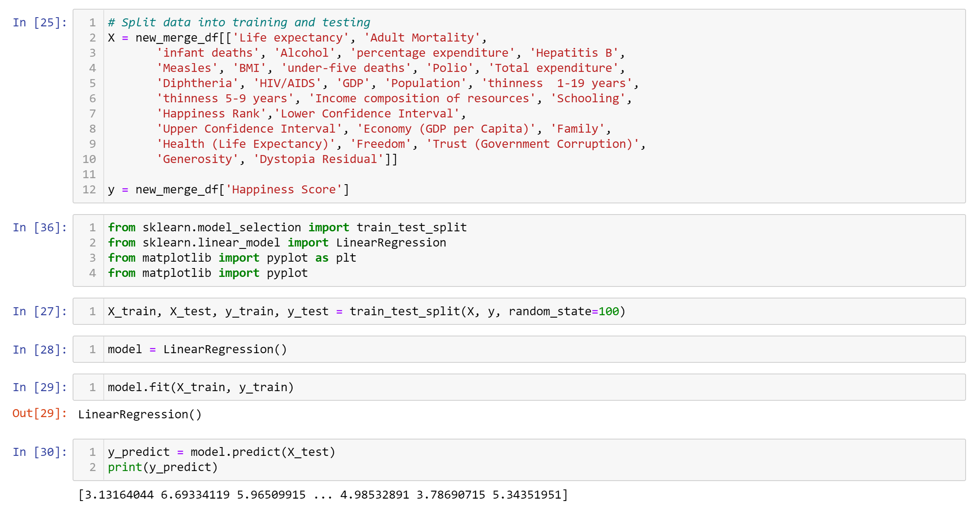
Analysis & Machine Learning Phase
Notes:
Duc

Slide 11
Analysis & Machine Learning Phase (cont.)
Economic/Health Factors
Country with the lowest predicted happiness score:
Burundi: 3.0665
Country with the highest predicted happiness score:
Netherlands: 7.4531
Future Analysis

Slide 12
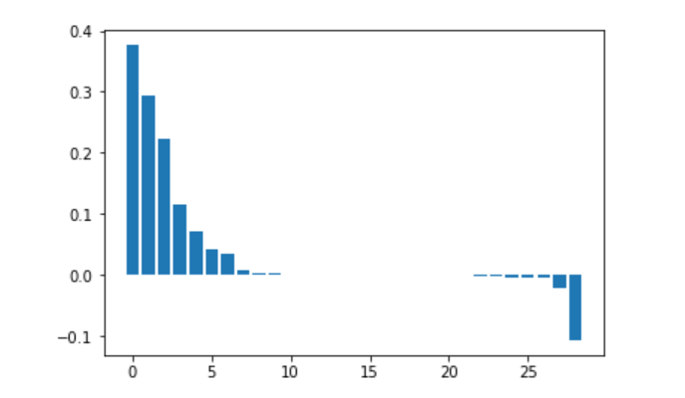
Analysis & Machine Learning Phase (cont.)
Results of Analysis
Feature Importance Graph
Highest Health Factors:
Alcohol: 0.00282
Life Expectancy: 0.00270
Family: 0.03388
Highest Economic Factors:
Freedom: 0.22304
Generosity: 0.11409
Economy (GDP per Capita): 0.07213
Lowest Health Factors:
Health (life expectancy): -0.02122
Thinness 5-9 years: -0.00459
HIV/AIDS: -0.00431
Lowest Economic Factors:
Trust (Government Corruption): -0.10733
Schooling: -0.00167
GDP: 0.000
Notes:
Duc

Slide 13
Dashboard Review
Dashboard
Originally started with Flask transitioned to Tableau
Shows model predictions vs actual test data
Gives a visual representation of what the underlying data looks like
https://public.tableau.com/profile/jp4411#!/vizhome/SemiFinalDashboard/Dashboard1
Notes:
JP

Slide 14

Github Administration
Project Management Role
Being the go to git resource
Assisting teammates with github errors
Coordinating with team members about their piece of the project
Merge Conflict Resolution
Lessons Learned
Communication is essential
All team members getting in the habit of working with branches
Establishing a folder structure early on
GOOGLE GOOGLE GOOGLE
Notes:
JP

